Slide 1
Unit 2: Challenge and Change
CLOSE TO HOME
Views on Adolescence and Development
Growing Trends and Challenges for Adolescence and Their Families

Slide 2
Views of Adolescence: Socialization and Development
Throughout this chapter we are going to;
define adolescence and introduce the important theories that explain socialization and development;
look at different value systems among generational groups in Canada;
View agents of socialization such as family, peers and teachers that shape behaviour.

Slide 3
Origins of Adolescence
Adolescence – refers to a transitional period between childhood and adulthood typically beginning with puberty and ending around 18-21 years of age.

Slide 4
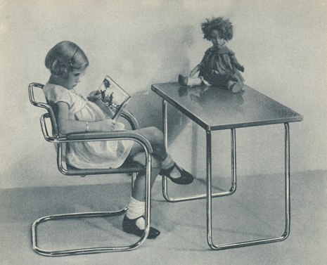
In many cultures, children enter adulthood without much assistance and the transition is usually harsh and abrupt.
Going through a smooth transition with a lot of time to waste is not often heard of.

Slide 5
History of Child Labour
From 1750- 1860, children as young as 11 were responsible for bringing in income from the factories and manufacturing plants.
By1860 there was no need for children to work on farms thus compulsory education for children age 14 and under was implemented in 1871 in Ontario
Child labour laws passed in 1880

Slide 6
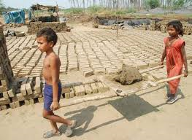
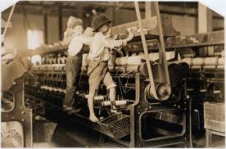
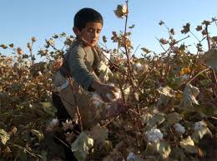

Slide 7
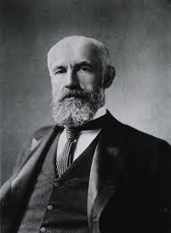
G. Stanley Hall
Psychologist G. Stanley Hall
(1844-1924) was very popular for his study on adolescence.
His research was beneficial when the laws began moving from adolescence working outside the home to children staying home and developing at a slower rate.

Slide 8
With G. Stanley Hall’s contribution to the transition of the adolescent years, children now had the opportunity to transition at a much slower rate while developing and socializing.
This also gave children more time to mature and assume their positions and responsibilities in the adult world.
Do you believe this was a good shift?
Do you believe children are coddled too much in todays society?

Slide 9
Elkind’s Theory of Adolescent Egocentrism
David Elkind (1931- )is a psychologist looking at the socialization and behaviour of adolescence.
According to Elkind, the primary feature of this stage is the immaturity level and thinking process.

Slide 10
Elkind’s Findings:
He found that adolescence have an under-developed portion of the brain that is responsible for reasoning.
With this lack of reasoning abilities, he also contends that adolescence is a period marked with indecisiveness due to exaggerated self-consciousness.

Slide 11
Teenager are often idealistic but simultaneously they can be very critical; they tend to envision an ideal world and criticize it at the same time.
Elkind believe that due to the lack of reasoning, teenagers often feel they are invincible and invulnerable.
This is believed to lead to risk-taking behaviours like speeding, extreme sports or drinking and trying drugs.

Slide 12
Egocentrism – heightened self-awareness and self-consciousness
Teenagers tend to believe that others are as interested in their lives as they are in themselves. This is called an imaginary audience.
Teenagers often imagine they have a captive audience watching and commenting or judging on all of their actions. This is called personal fable.
This governs their beliefs that they are higher than all laws or rules of society.

Slide 13
What do you think?
Consider our lesson on generation Y.

Slide 14
Socialization
Socialization is the process by which we learn to become members of society, by internalizing norms, values and beliefs.
We learn this by observing the roles of our parents, teachers elders and other people.

Slide 15
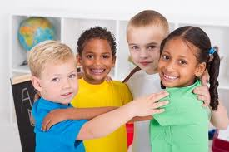
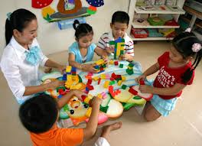
Primary and Secondary Agents of Socialization
Primary agents of socialization is immediate family and extended family.
Secondary agents of socialization is school, peers, teachers, religious figures, culture and media.

Slide 16
The Growing Influence of Social Groups
When adolescence are faced with life changing decisions it is often hard for them to make the right decision without thinking about both what their parents are teaching them and what their friends are saying and doing.
Peer-pressure is a very common issue among teenagers and even younger children.

Slide 17
Allison Davis and Socialized Anxiety
Socialized anxiety refers to the tension and discomfort felt by individuals that motivate and influence behaviour.
For example, the anxiety of getting into university or college is motivating students to work hard and do well in their courses.
This helps students move toward maturity.

Slide 18
Strauss-Howe Generational Theory
William Strauss and Neil Howe identified that many generations follow a repeated pattern or learn from previous patterns.

Slide 19
Generation Characteristics
G.I. Generation (1901-1924) | -WWI survivors -determined to overcome hardships
Silent Generation (1925-1942) | -WWII survivors -experienced the Great Depression and economical hardships. -had no money to support families.
Baby Boom Generation (1943-1960) | -had to rebuild society after the destruction of the war. -very careful with money because they saw how difficult it was for families to survive. -uncomfortable with change
Generation X (1961-1981) | -Disillusioned with social structures and institutions. -were not as good at saving because they grew up with frugal parents.
Generation Y or Millennial Generation (1980-2000) | -witnessed 9/11 yet optimistic and resilient. -on-going war and terrorism and aware of global crisis -receptive to change
Generation Z (2001-2020) | -influence by growing technology

Slide 20
Generational Replacement
This is the theory that claims changes in adolescent attitudes are important markers of longer-term social change.
This means sociologist believe the interests and ideas teens have about social issues will create a trend toward change within society.

Slide 21
Growing Trends and Challenges for Adolescents and Their Families.
In this sections, you will learn social challenges today’s adolescents and their family face.
Growing trends in teens socializations
Characteristics of behaviour and attitudes among teens.

Slide 22
Studying Growing Trends
One of the major ways of conducting research about teens and growing trends in Canada is by looking at the demographics.
Demographics is the statistical study of populations which is predominately used for forming public policy and marketing.

Slide 23
Socializing Trends and Challenges
What personal values and behaviours do you attribute to your family and upbringing?

Slide 24
The Emergence of Canadian Teens
Tweens young girls and boys, typically between the ages of 8 and 13.
This is the stage which tweens begin to develop adolescent behaviours and values.

Slide 25
Children have become socially relevant and are motivated and encouraged to express their individuality starting at a very early age.
They are often considered stakeholders in large family decisions which was never a trend before.

Slide 26
Some issues facing tween;
- they are adopting teen behaviours and attitudes
-they are often dealing with similar problems and mental health issues like depression and suicidal.
-crime rates among tweens is increasing.
- a heightened hyper-sexualization of youth is increasing, especially among tween girls.

Slide 27
Sexualizing of Children
Traditionally, the fashion industry has geared their products toward adults.
In recent history, children are wanting to emulate the adults they see fashion wise.

Slide 28
Social Issues
More and more teens are developing eating disorders and suffering from lack of self-confidents
Young girls in particular are inspiring to be actresses and models rather then doctors and lawyers.

Slide 29
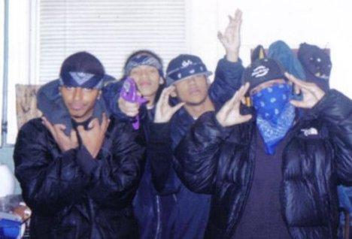
Challenges to Social Relationships in Adolescence
Teens often have a “need to belong” that could be greater than an individuals own values and regard for personal risk.
Ex. Some teenagers may
consider joining a gang.
For these teenagers they
may be more drawn toward
the partnership and relation-
ship with the people rather
than the problems it
can cause.

Slide 30
Discussion (15 minutes)
With a partner, discuss ways in which teenagers conform to society or social group norms.
Be ready to present your ideas!

Slide 31
Adolescents and Technology
Social Networking
Children and teens are more proficient in technology then ever before.
Social networking has both positive and negatives in the world today.
With a partner, discuss some of these pros and cons.

Slide 32
Cyber-bullying
It is a relatively new issue with teenagers posting all of their personal business online such as relationships, pictures, comments and statuses.
Having this direct access to people, this opens a door for bullies
As we know, this is a major issue that is rising in North America and the world.

Slide 33
What are some cyber-bullying stories you have seen in the media?
Hannah Smith
14 years old
Amanda Todd
15 years old

Slide 34
Amada Todd
Amanda Todd was a 15 year old teenager who was a victim of relentless bullying.
Here is her story…
http://www.youtube.com/watch?v=vOHXGNx-E7E

Slide 35
Suicide among Teens
Teen suicide and attempts have increase over the years. Sociologist believe this increase is due to social relationships.
Through history many sociologist have studied suicide; Emile Durkheim being a prominent researcher.

Slide 36
Current Social Issues
Toronto District School Board has just created a program to help students and teachers become more aware of mental health within their schools.
Director, Donna Quan states,
“In 2013, there was a reported 700 suicide attempt among adolescent and teen groups in the TDSB alone”.

Slide 37
What can be done? Is bullying getting all the attention and the victims are left without support and attention?
In a small group discuss ways which cyber-bullying can be eliminated.
What can each of the below institutions do to work toward a solution.
social media
political system
Legal system
parents
education system

Slide 38
What can we take from this lesson?
Bigger ideas?
What can we do?

