Slide 1
DEMOGRAPHY:
The study of human populations is called…

Slide 2
Demography:
The study of populations
This field explores and evaluates trends
Research data is used to study population growth patterns

Slide 3
Demography
Demography
P
S
A
Each field uses the information in different ways

Slide 4
Social Scientists
Look at the changes in population in different ways
Anthropologists: Study connection between cultures and trends
Sociologists: Study how trends relate to institutions and citizens
Psychologists: Study how the changes relate to the individual

Slide 5
SOME USES FOR DEMOGRAPHY
Identifying human needs and finding solutions:
Governments use demographic data to plan ahead (i.e. school construction projects, health care budgets...)
Marketing Tools:
Companies want to know which consumers use their products and how to make their products more appealing to these buyers

Slide 6
SURVEYS
Have you ever filled out a product survey?
Or, have you every answered market research questions over the phone?
What kinds of questions were you asked?

Slide 7
MARKETING AND THE STUDY OF HUMAN POPULATIONS
When you completed your survey, you were probably asked to give your age group
Companies want to know which consumers use their products
They also want to know how to make their products more appealing to those buyers
Age has a great deal to do with our interests, habits, tastes and spending
It is also a very important part of demography

Slide 8
DEMOGRAPHERS LOOK AT ISSUES ACCORDING TO LEVEL OF DEVELOPMENT OF THE COUNTRY
Less developed countries:
high levels of fertility.
high levels of infant mortality.
a high prevalence of HIV/AIDS.
high levels of out-migration to more developed countries.
______________________________________________
More developed countries:
low fertility patterns.
women having babies at later ages.
populations with below replacement levels of fertility.
and large numbers of migrants from less developed countries.

Slide 9
Industrialization has an impact…
Given the impact of industrialization in the reduction of fertility and mortality and the international migration flows from less developed to more developed countries around the world…
…it is a common practice among demographers to observe separately the demographic processes in less developed countries (also called developing countries) from those in more developed countries (also referred as developed countries).

Slide 10
GOVERNMENTS AND THE STUDY OF HUMAN POPULATIONS
Demographers provide useful information for governments
By using population statistics they identify different age segments and make recommendations about the social and economic needs of various groups
They can also project population growth rates into the future.
This information can be used to target things like job creation programs
Population data can also shape immigration policies.

Slide 11
KEY WORD: POPULATION
It means “…a collection of persons alive at a specified point in time who meet certain criteria.”
Not necessarily an entire country. Could be a segment of a country.
Such as, the population of… Canada
The population of… students at _______________

Slide 12
COMINGS AND GOINGS
There are only two ways to enter a population, by birth and by immigration (coming in to a country).
There are two ways to leave a population, by death and by emigration (leaving one’s home country to another).
Therefore, three processes are relevant to demography: Fertility, Mortality, and Migration

Slide 13
How Population Changes
Can increase/decrease as a result of two factors:
1. Natural increase/decrease – babies born is greater than the number of people dying vice versa.
2. Net migration – observes the immigration vs. emigration trends
End of WW1 important effect on demography- rise in immigration- most from war-torn Europe- more than 2 million people came to start a life- gave top priority to Britain and the Commonwealth- Europeans, Americans
Notes:
Immigration- racist at the time- only about 2 percent of all immigrants accepted from Asia, Africa, and South America- 1957

Slide 14
The Changing Population
Natural increase: When births exceed deaths
Natural Decrease: When deaths exceed births
BIRTHS
DEATHS
DEATHS
BIRTHS

Slide 15
Calculating the Population
Births – Deaths
= Natural Increase
(Natural Decrease)

Slide 16
Calculating the Population
Immigration - Emigration
=Net Migration

Slide 17
Migration
Immigration
When people move into Canada
Assists in matching the declining birth rate
Brings new cultures and skills to the country

Slide 18
Migration
Emigration
When people move out of Canada
The majority of Canadian’s abroad are in the United States
The United Kingdom is second

Slide 19
Calculating the Population
Natural Increase/(Decrease) + Net Migration
=Population Change

Slide 20
Calculations: PRACTICE
 | Births | Deaths | Natural Increase (Decrease) | Immigration | Emigration | Net Migration | Population Change
ex | 264 | 12 | 252 | 77826 | 1756 | 76070 | 76322
1 | 5000 | 650 |  | 100000 | 26000
2 | 7594 | 852 |  | 2500 | 89
3 | 478 | 683 |  | 7 | 96
4 | 1254 | 90 |  | 785 | 56
5 | 500 | 250 |  | 8900 | 5600

Slide 21
Populations and Generations
Key generations from the past 50 – 100 years
The Baby Boom Generation (born 1946-1966 )
Boomers, yuppies / dinks
Generation X (1960-1966)
The Baby Bust Generation (1967-1979)
The Echo Boom Generation (1980-1995)
Generation Y
Generation Z (1996-2010)
Millennium Kids
If we think of the baby-boom as a ripple-effect in water (second wave is an echo of the first), how do subsequent generations affect our social institutions?
This population trend will taper off, but then becomes the question – what other factors contribute to population?

Slide 22
StatsCan, 2006

Slide 23
Baby Boom
Born 1946 – 1966
Very high birth rate
Became a force to be reckoned with
Sought social change (anti-war; anti-nuclear, women’s liberation, civil rights)
Suburbia
Child-centred (nuclear family)
Sexual revolution (the Pill)
Counterculture

Slide 24
Generation X 1960-1966
Grew up with Materialism – way of life that revolves around material possessions
How would you describe your upbringing? What major factors affected your generation growing up?

Slide 25
Cause of the Baby Boom
World War II – returning soldiers took wives – marriage was the norm
Sex outside of marriage was frowned upon/condemned in this era
Increased immigration – increased promise from “old land”

Slide 26
Causes of the Baby Boom
http://www.youtube.com/watch?v=2YARsz7rJU4
End of WWII
1 in 5 Canadian soldiers came back with a war bride – almost 50,000 women and children
Men were anxious to resume their lives – marriage rates were double pre-war rates
Notion that marriage and family was the quickest route to respectability – failure to marry proved immaturity, parental complex, inferiority complex and narcissism

Slide 27
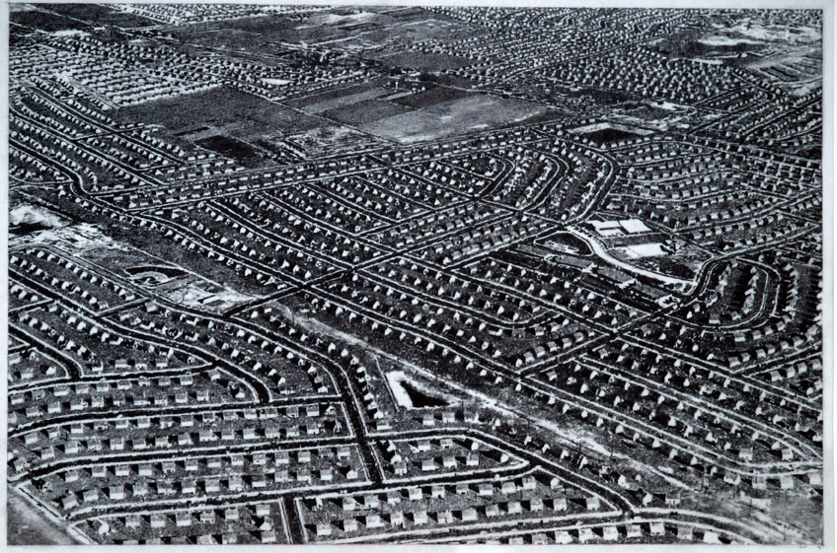
Levvittown - Suburbia
Before:
After:
What were the motivations to “settle down”?
Notes:
-limited construction of new housing during great depression (1930’s) and wartime- therefore shortage of accommodation- newly married couples lived with family
Demand for housing triggered tremendous construction boom- built in urban areas ‘suburbia’
Marriage considered norm- sex outside of marriage- socially condemned- marriage was a moral necessity upon- not married ‘parental fixation, immaturity, inferiority complex, narcissism (self-centered), confirmation of homosexuality.

Slide 28
Causes Continued…
Immigration
More than two million people came to Canada from 1945 – 1960
Most immigrants came from Western Europe and USA
Many immigrants were young couples seeking a better life, adventure and to start a family

Slide 29
Bringing up the Boomers
Post war economic boom meant that Boomers
were raised in a prosperous time
Suburban Culture – huge demand for family
housing
Car became a necessity –car culture… drive in
restaurants, theatres, shopping centres…
Young families: 1961 census – nearly 50% of the
population of the suburbs was under 15, less than
10% was over 55
Nuclear family – grandparents lived elsewhere
Overcrowded hospitals, schools, universities… solution
was to expand – created national debt that we still have

Slide 30
Counterculture
Counterculture – young people express values that conflict with society’s norms
1960’s saw counterculture with protests, rebellion, and change in music (Beatles, Led Zeppelin (70’s))
Political activism was popular with young people

Slide 31
1960s Counterculture
Did permissive parenting + child centred education create a generation of long haired rebels?
Boomers didn’t seem to follow the rules – hippies, drugs, The Beatles, Vietnam, “Sit-ins”, peace symbols, Trudeau-mania, Woodstock, etc.
Had large collective voice… and used it!
Many interested in political activism - Vietnam War, Civil Rights Movement, Nuclear Technology, Environment – Green Peace, Women’s Rights, Minority Rights…

Slide 32
The Who: My Generation
Some saw 1960s counterculture as: “self-centered crowd of long-haired rebels”
By the mid to late 1960s the early boomers had reached their teenage years
Popular songs expressed attitudes of a generation that didn’t follow rules or care much about people older than themselves
http://www.youtube.com/watch?v=5MnDbWqe_kQ

Slide 33
Lyrics: “My Generation”
People try to put us d-down (Talkin' 'bout my generation)
Just because we get around (Talkin' 'bout my generation)
Things they do look awful c-c-cold (Talkin' 'bout my generation)
I hope I die before I get old (Talkin' 'bout my generation)
This is my generation
This is my generation, baby
Why don't you all f-fade away (Talkin' 'bout my generation)
And don't try to dig what we all s-s-say (Talkin' 'bout my generation)
I'm not trying to cause a big s-s-sensation (Talkin' 'bout my generation)
I'm just talkin' 'bout my g-g-g-generation (Talkin' 'bout my generation)
This is my generation
This is my generation, baby

Slide 34
Sexual Revolution
Children born to unmarried mothers rose 5% between 1960-1970
“The Pill” (1961) – birth control – contributed to the collapse of the Baby boom
Became widely available and affordable
Results???
Women stayed in school longer + began to pursue careers
Led to declining birth rates…and an end to the Baby Boom
How do current “norms” of society reflect sex? Single mothers?

Slide 35
Impacts of the Baby Boom
Dependency Load – portion of the population that is dependent – not actively employed
How will this impact society and social institutions? Will Baby-boom burden you?
Seniors in Canada:
1991: 65+ = 3.2 million (12%)
2011: 65+ = 4.9 million (14%)
2021: 65+ = 6.6 million (18%)
2031: 65+ = 8.3 million (22%)

Slide 36
Generation Y: The Echo Boom
Born 1980-1995 (YOU& ME!)
Echo: analogy of waves in the water; reflects the original baby boom, but a separate social and economic influence
Children of the Baby Boomers
Consists of approximately 7 million people, a reflection of the declining birth rates of the Boomers
Also called Generation Me, Internet Generation, Echo Boomers, the Boomlet, Nexters, Nintendo Generation, Digital Generation

Slide 39
Economic Impact
Echo kids are one of the first group of youth to work en masse
Large disposable income and huge buying power
“The brand name is increasingly important. Echo kids have been saturated in television since birth and, as a result, they are the most brand conscious cohort in the history of the planet

Slide 40
Social Impact
The global generation, the connected generation
Belief that youth can make a positive social impact
Concerned with issues such as terrorism, global warming, AIDS, poverty, cancer, environmental degradation, war, depleting resources…
Full of potential and ability to act
Free the Children

Slide 41
Media
Where media was previously focused on the Boomers, it has shifted toward the Echo kids
They’re the first generation to grow up post 9/11, surrounded by digital media:
Electronics, computers
Fashion
Focus on experiences – Reality TV, Extreme sports, You Tube
Obsession with celebrities

Slide 42
Music of the ’90s
The “Grunge” era enters the music world with bands like Nirvana, Pearl Jam and Sound Garden
Nirvana opens the market with their new style and their dark messages
Pearl Jam and other bands also reflect this message

Slide 43
What do you think?
Many people have negative views of teenagers and youth:
Obnoxious, selfish, lack of respect for parents, teachers and the law (out of control?)
Increasing rates of youth violence, school shootings, girl gangs
Promiscuous behaviour, drinking, drug use

Slide 44
What defines your generation?
Is Generation Y out of control (more rebellious, more criminally inclined, more violent)? Or is Generation Y the victim of negative stereotypes?
How would you describe your generation with regard to its beliefs, values and interests?
Read 164-165, Questions 1-4

Slide 45
Demography
Why is demography useful?
1946: Dr. Benjamin Spock – “respect children as they are human beings who deserve respect” – Did/Does this mentality “corrupt” youth?

Slide 46
What Song best Defines Generation Y? Group Assignment

Slide 47
Childlessness in Canada

Slide 48
Economic Impact
Declining birthrate means less young people to supplement the labour market
Issues for the pension plan
More need for housing and care for the elderly
Canada needs Immigration to maintain its population

Slide 49
Increasing Naturally
Replacement level is the number of births needed to maintain a stable population
Fertility refers to actual reproduction
Fertility rate is the actual number of births per woman

Slide 50
Replacement Level
Canada’s replacement level is 2.1
Births and total fertility rate, by province and territory
 | 2006 | 2007 | 2008 | 2009 | 2010
 | total fertility rate
Canada | 1.59 | 1.66 | 1.68 | 1.67 | 1.63
Ontario | 1.52 | 1.57 | 1.58 | 1.56 | 1.53
Source: Statistics Canada, CANSIM, table 102-4505. Last modified: 2012-09-27.

Slide 51
Interesting Note
No G8 country has managed to get to a replacement level of 2.1 (the target for a developed nation)
Canada, United States, United Kingdom, Russia, Japan, Germany, France, Italy,
Sociological view might look at the connection of wealth to fertility and desire to have children.
Notes:
http://www4.hrsdc.gc.ca/.3ndic.1t.4r@-eng.jsp?iid=35

Slide 52
Fertility
Women 30-34 had the highest fertility rate in 2006
Surpassed women 25-29 for the first time
Confirms decision to delay childbirth
Canada's fertility rate at 10-year high: StatsCan. (2008).CBC News Online. Retrieved from http://www.cbc.ca/news/health/story/2008/09/26/fertility-rate.html
Notes:
http://www.cbc.ca/news/health/story/2008/09/26/fertility-rate.html

Slide 53
Fecundity
Fecundity is the ability to reproduce
A woman is fecund if she has the potential to bear offspring
Affected by diet and health
The opposite of fecundity is being sterile (unable to naturally produce children)

Slide 54
Fertility, Fecundity and Culture
Culture influences:
Health (diet can effect fecundity, maternal health, menarche)
Beliefs about child rearing
Desire to have children
Number of children wanted

Slide 55
The Child Free Choice

Slide 56
Voluntary Childlessness
Voluntary childlessness is when people choose not to have children
They are fecund (able to have children)
The number of people in Canada that intend to stay childfree has remained constant
Results in stereotyping and misunderstanding
People must justify the choice to not have children

Slide 57
Article Analysis
Read Childfree by Choice
Answer Questions:
What percentage of 20-34 year olds intend to remain childfree? Is it very different for men and women?
What role does religion, education and income have in the decision?
Do we still live in a “kidcentric” society?

Slide 58
Involuntary Childlessness

Slide 59
Involuntary Childlessness
People that want children but are unable to conceive for different reasons
Infertility: being unable to have children naturally; absence of actual reproduction
Cannot find a suitable mate
Cultural Issues
Infertility of mate

Slide 60
Infertility
A couple must have been trying to conceive for over a year without success
Several factors can contribute to infertility
STI’s, illness, age
Estrogen levels
Chemicals such as BPA’s
Can lead to emotional distress

Slide 61
Assisted Child Rearing
Infertility can be assisted
Adoption
Reproductive technologies
IUI, AID, IVF, GIFT
Surrogacy

Slide 62
Adoption
Does not change the population since the births are already recorded
Alters who demographers/census counts as the family
Changes who is legally responsible for the child/youth

Slide 63
Adoption
Some facts from the Adoption Council of Canada (adoption.ca)
Public (foster care): $0 - $3,000
Licensed Private Agency: $10,000 - $20,000
International: $20,000 - $30,000
Approx. 30,000 children available for adoption

Slide 65
Reproductive Technologies

Slide 66
Psychological Impact
Emotional Devastation
Shock of being infertile
Feelings of
Guilt: letting others down
Sadness: dreams not fulfilled, mourning loss
Loss of control: life plan changes
Anger:
Isolation: private grief

Slide 67
Infertility in Canada
Infertility is on the rise in Canada
Has doubled in 20 years
1984: approx. 5% of couples with a female partner age 18-29
2009-10: same group ranged from 7% to 13.7%.
Sources: National Post, http://news.nationalpost.com/2012/02/15/infertility-on-the-rise-in-canada-study; Drink Aware, http://www.drinkaware.co.uk/check-the-facts/health-effects-of-alcohol/fertility-and-pregnancy/alcohol-and-reproduction#longtermfertility
Notes:
http://news.nationalpost.com/2012/02/15/infertility-on-the-rise-in-canada-study/
http://www.drinkaware.co.uk/check-the-facts/health-effects-of-alcohol/fertility-and-pregnancy/alcohol-and-reproduction#longtermfertility

Slide 68
Infertility in Canada
Reasons for the rise:
Obesity: interferes with ovarian functioning; lowers sperm count
Chlamydia and Gonorrhea: Left untreated can cause long term reproductive damage
Heavy smoking and drinking: Increases chances of infertility and miscarriages
Sources: National Post, http://news.nationalpost.com/2012/02/15/infertility-on-the-rise-in-canada-study; Drink Aware, http://www.drinkaware.co.uk/check-the-facts/health-effects-of-alcohol/fertility-and-pregnancy/alcohol-and-reproduction#longtermfertility
Notes:
http://news.nationalpost.com/2012/02/15/infertility-on-the-rise-in-canada-study/
http://www.drinkaware.co.uk/check-the-facts/health-effects-of-alcohol/fertility-and-pregnancy/alcohol-and-reproduction#longtermfertility

Slide 69
Overcoming Infertility
Technology has advanced enough to give couples experiencing infertility the potential to conceive (to become pregnant)

Slide 70
Reproductive Technologies
There are four technological methods available to infertile couples
Intrauterine Insemination (IUI)
In Vitro Fertilization (IVF)
Gamete Intrafallopian Transfer (GIFT)
Artificial Insemination Donor (AID)
A surrogate can be used for all instances

Slide 71
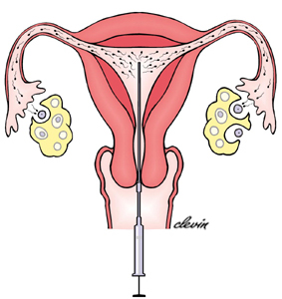
Intrauterine Insemination (IUI)
Assists in making the sperm and egg meet
Woman provided with drugs to increase ovulation
Sperm is carefully selected
Directly inserted near the fallopian tubes

Slide 72
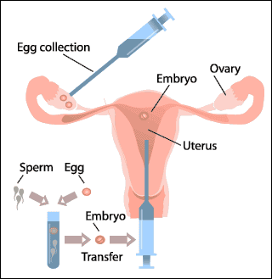
In Vitro Fertilization (IVF)
Typically used when woman has blocked fallopian tubes
In Vitro= In Glass
Sperm and eggs are combined in the lab
Embryo is inserted into the uterus

Slide 73
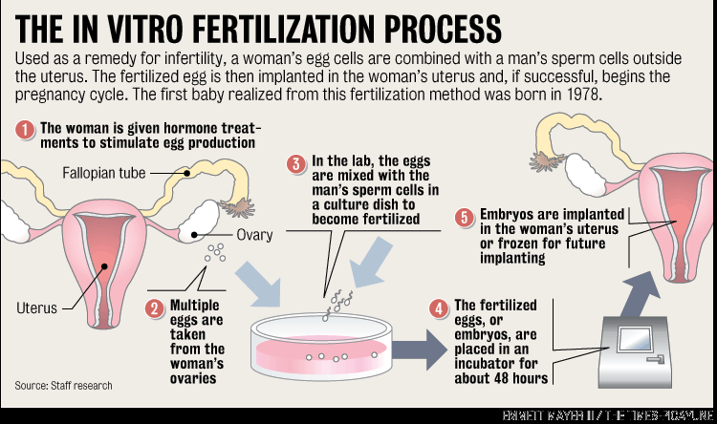
Source: Nola.com, http://media.nola.com/news_impact/images/ochsner-in-vitro.gif

Slide 74
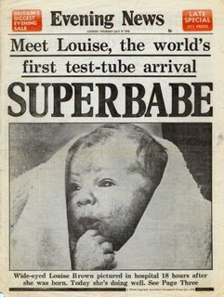
In Vitro Fertilization
Louise Brown, first successful “test tube” baby
Born July 25, 1978
Great Britain
Lesley Brown had blocked fallopian tubes
Doctor’s performed the experimental procedure
It had never resulted in birth
80 failed attempts

Slide 75
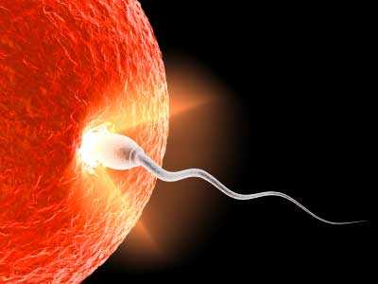
Gamete Intrafallopian Transfer (GIFT)
Similar to IVF
Sperm and egg are mixed together
Placed in fallopian tube for more natural fertilization

Slide 77
Artificial Insemination Donor (AID)
Sperm for any of the methods can be used from the partner or from a donor (friend, family, unknown)
Used if the partner has genetic problem, low sperm count or poor quality
Sperm and semen are analyzed and frozen in a cryoprotectant

Slide 78
Costs
Depending on the health condition and the procedure prices range from $500-$10000/attempt
IVF Canada: http://ivfcanada.com/index.php?route=common/home

Slide 79
Coverage
In Ontario fertility tests are paid for under OHIP
Fertility treatments are not fully covered
In Quebec fertility treatments are covered
As of August 2010
There are discussions about adding treatments to OHIP
Notes:
http://www.ivfcanada.com/

Slide 80
Article:
http://business.financialpost.com/personal-finance/the-cost-of-infertility
http://www.babycenter.ca/a1028300/cost-of-fertility-treatments-in-canada

Slide 81
Should this be covered by OHIP?
YES | NO

Slide 82
Surrogacy
Surrogate = substitute
A woman carries a pregnancy for another
Can be done using IUI, IVF, GIFT
Recommended in cases of multiple miscarriages, failed IVF, uterine defects
Used for different personal reasons
Egg can come from non-carrying mother and sperm can come from father

Slide 83
Surrogacy and Parental Rights
Contracts are used between surrogate and parent
Sometimes parents decide they do not want the baby or surrogate wants to keep the baby
Courts sometimes used decide who is the real parent

