Slide 1
Health and Wellness
HSB4U1

Slide 2
Class Share
The last time I was sick…
I felt like…
I looked like…
I took/did…
There are a number of factors that affect ones health and well- being.
How we live out our lives and how we cope with stress affect our ability to remain healthy and happy.
Conditions within our society affect our access to high quality health care
As the values of society shift, so do the approaches to various ethical issues related to health care.

Slide 3
What is Health:
The absence of an illness requiring medical attention.
Think positively
Exercise daily
Eat healthy
Work hard
Stay strong
Worry less
Dance more
Love often
Be happy

Slide 4
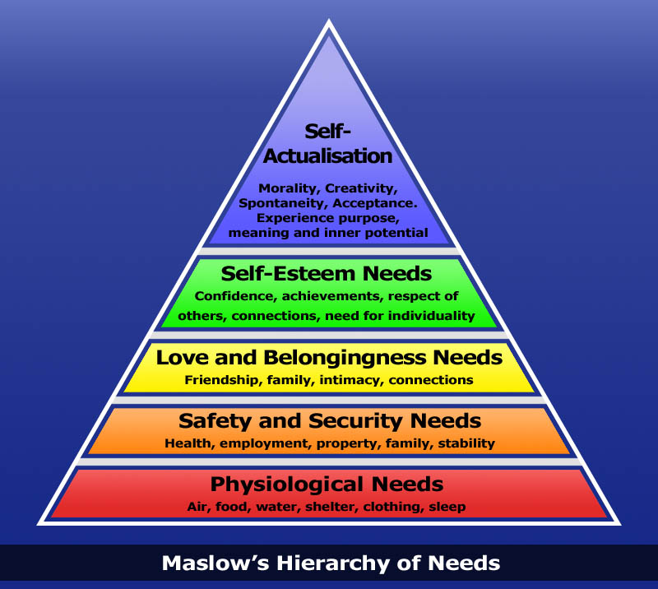

Slide 5
(Re) Defining Health
Health care needs must be met to move up in the hierarchy
Health is a part of safety and security
Life is more difficult when needs are not met
Being unhealthy is no longer simply a matter of sanitation and cleanliness

Slide 6
(Re) Defining Health
mental
physical
emotional

Slide 7
Anthropology:
Focus on two aspects of human health
1. Domestic scale cultures small kinship societies in which production and distribution of goods is organized on a household basis
- ie. Tribal cultures that are typically very healthy (tribes in Amazon- James Neel 1970)
- were in excellent physical condition – diets include high fibre, low fat, low population density, active lifestyles, isolation from viruses from the outside world
- isolated from the viruses from the outside world- avoid morbidity (illness or physical harm)
- Opposite of mainstream Western medical practices which achieve overall good health by developing technologically sophisticated cures for diseases.
2. Status of health among modern industrialized societies observe declining social cohesion and growing stress (typically in these cultures) lead to increase risked of disease.

Slide 8
Psychology:
Clinical and Research Practice-
Clinical deals with health- looks at the assumptions of psychology generally, believing that the individual factors related to the patient rather than larger societal factors can be best explain why people become ill.
Clinical psychologists frequently practice their professions in association with hospitals and mental institutions.

Slide 9
Sociology:
Examine-
Social structures, allocation of resources and social practices (activities and behaviors of people in groups) affect overall health.
Ie, Canada, too many people lead sedentary lives, diet consists of too much fat and insufficient fiber and vitamins, eat too much fast food and lead busy lives, tobacco and alcohol consumption is another major detriment to health.
Sociologists ask what can society do about the situation- will allocating more funds to health care have an impact?
Discuss:
If lifestyle is the main contributor to bad health and death- where might we better utilize the money?
Change medical model from reactive to proactive- treat the underlying issue not just the symptom.
Sociologists look at how we need to examine and shift away from the MIM and replace with HPP.
Medical intervention model:
Doctors will cure all
Reactive
Health promotion perspective:
Healthy lifestyles are best
Preventive
Efforts from many social institutions

Slide 10
Sociology cont…
Sociologists examine how health care systems are structured, how much it costs and who has access to it. Also, whether or not it is representative of the needs of the greater society.
Costs for health care are rising- in particular as our population ages and new (expensive) technologies emerge.
To contain costs a variety of tests and procedures, once paid for by the provincial health care plan- have been delisted- made ineligible for coverage.

Slide 11
3 social practices/ issues and their impact on health:
Breast- feeding vs. formula feeding
Isolation and depression among the elderly
Smoking among teenagers
Read pages 251-255 and take notes

Slide 12
Discussion:
Is formula feeding, especially in developing countries, a modern and scientifically proven way to ensure that babies receive all nutrients they need for healthy development?
What is the best solution for dealing with isolation and depression among the elderly?
What factors pressure students to smoke? In your school environment, how are student smokers regarded by other smokers? By non-smoking students?
Under Ontario provincial law, it is an offence for anyone to smoke on any property owned by a publicly funded school board. Do you think that this is a good law? Why or why not?

Slide 13
Social change – pandemics & epidemics

Slide 14
Epidemic vs. Pandemic
Epidemic - a widespread occurrence of an infectious disease in a community at a particular time.
Pandemic- is an epidemic of infectious disease that has spread through human populations across a large region (international)- Global disease- new subtype of a virus arises and therefore no immunity to it.

Slide 15
Medicine and Change
Life expectancy has increased drastically over the last 100 years (1981 seniors = 196 000 → 2056 seniors = 2.5 million)
  Sir Alexander Fleming discovered the antibiotic, Penicillin
  Significantly reduced number of deaths caused by infections
If we continue to live longer, what other areas of society will need to change to meet the needs of people?

Slide 17
Modern Pandemics
SARS
Influenza A subtype H1N1 (Swine Flu, but not really…)
West Nile Virus
Influenza
HIV/AIDS
Ebola
Obesity
Spanish Flu

Slide 18
Infectious Pandemics
For each recent pandemic, find the answers to the following:
1. Briefly describe the pandemic
2. Who was affected? (countries and stats)
3. Outline how society has changed as a result of this pandemic?
4. Evaluate society’s preparedness for a possible outbreak of this sort?

Slide 19
Immunization
All Ontarians are required to meet immunization standards
Schools require students to be immunized before attending
  can be exempt from immunizing your child if you get a medical excusal or won’t due to religious/philosophical reasons
  This is one explanation behind the recent measles outbreak in Ottawa
What would prevent someone from wanting an immunization?

Slide 21
http://www.health.gov.on.ca/en/public/programs/immunization/static/immunization_tool.html#pregnancy

Slide 22
Your Turn!
Should the government be able to mandate vaccinations for everyone?
How could this notion change society? (politically/socially →human rights)
Evaluate the fears of immunization. How can these be a barrier to change?
What is your perspective? Should every Canadian be immunized regardless of religion/philosophy?

Slide 23
Read:
Page 266-267 and identify that major characteristics of (a) a one-tier and (b) a two-tier system of health care directly. Which do you think make most sense in Canadian Society?
Why?

Slide 24
Ottawa Charter of Health
Read and Answer
Medical Panel Assignment
PAUSE

